Slide 1
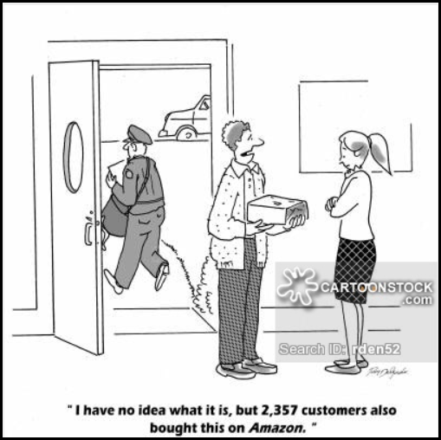
Online Reviews

Slide 2
Question
Can we use product reviews as a predictor for sales at REI?
Do product Reviews affect sales?
Furthermore, are there certain key words that drive an increase in orders for a given product?

Slide 3
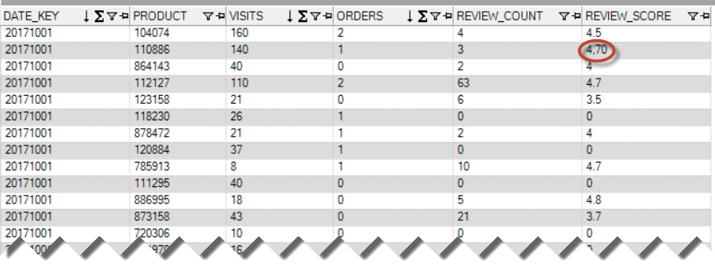
Methodology
What data have you gathered and how did you gather it?
Ran a query on our internal data base to pull by product: review count, average review, number of product views, and number of orders placed.
What areas of the data have you cleaned/still need to be cleaned?
Commas need to be converted to periods in ‘REVIEW_SCORE’
REVIEW_SCORE converted to float64

Slide 4
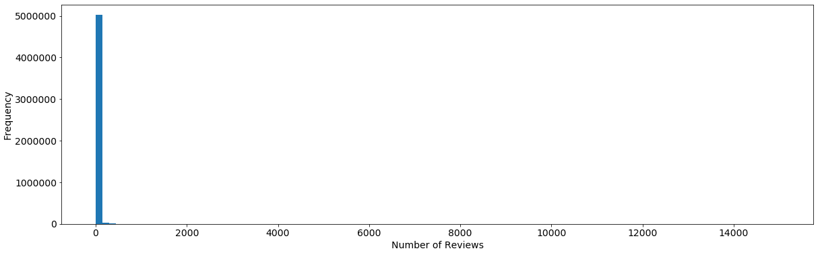
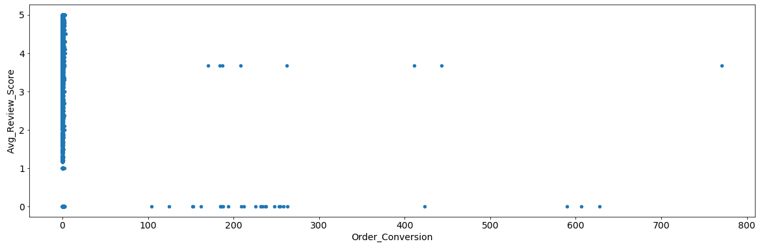
exploration
What steps have you taken to explore the data?
Histograms
Scatter Plot

Slide 5
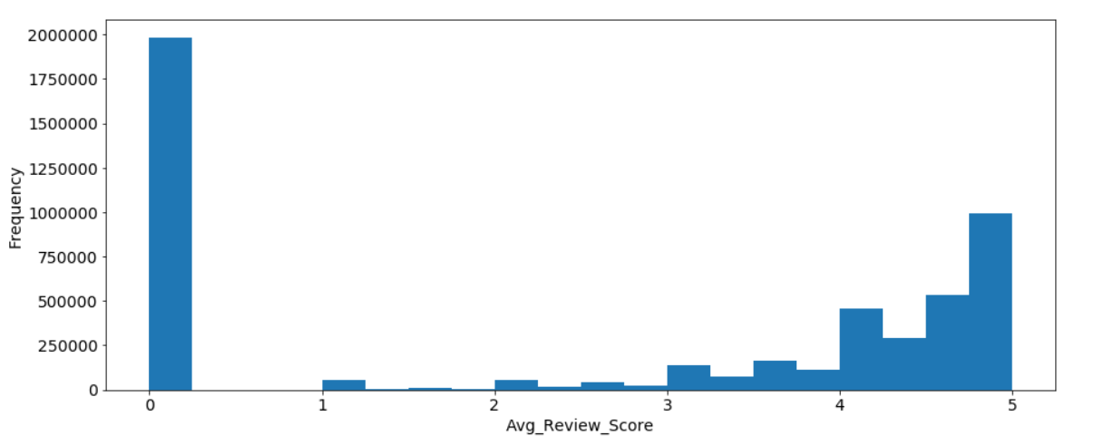
Insights (so far)
What insights have you gained from your exploration?
Of all products currently available on rei.com, most have no reviews, followed by those with an average score of 5

Slide 6
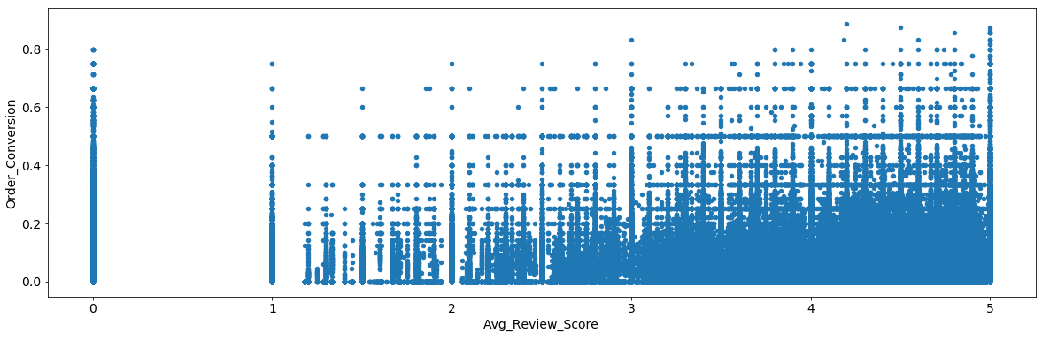
Future analyses
Will you be able to answer your question with this data, or do you need to gather more data (or adjust your question)?
Right now I have too much data to parse through. It’s too much to see patterns in a scatter plot. I need to pull in more dimensions, such as product type and price point. Are there patters within a specific product type, rather than overall products?

